Slide 1
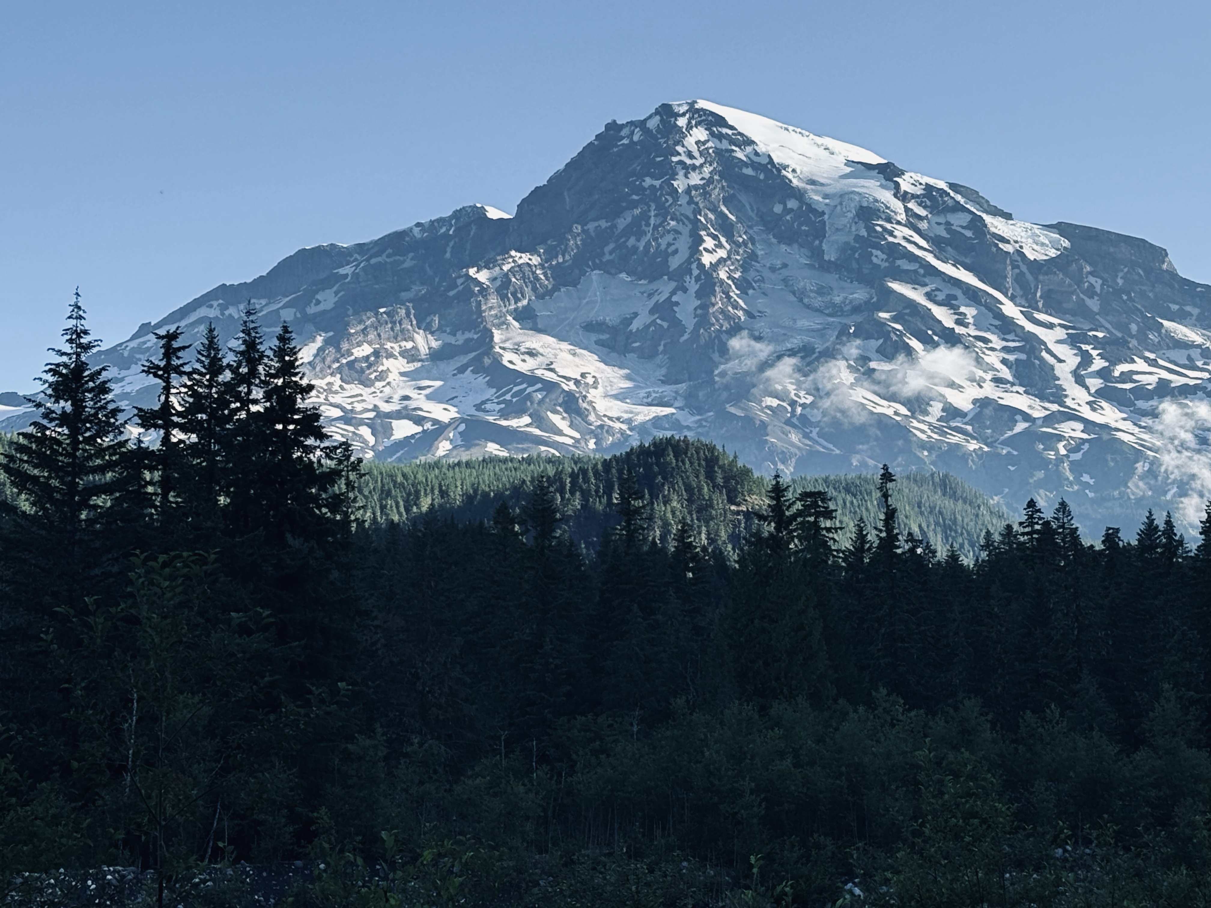
A Fine Balance’: Exploring the Interplay of Reproductive Strategies and Growth Dynamics in Trees
Xiaomao Wang
Oct 19 2025

Slide 2
Growth-reproduction trade-off
RESOUCES
Defense
Growth
Reproduction
Storage
Trade-offs help to maximize plants’ fitness when resources are limited

Slide 3
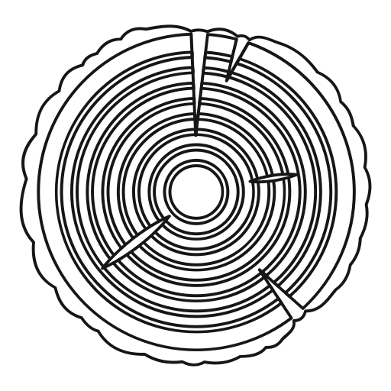

Masting hypotheses related to trade-off
Resource matching
Environmental cues

Slide 4
-
Growth
+
Masting
# Cones
# Seeds
Non-constant
allocation
Cues
Climate
Vetos
Non-masting
Growth
Constant
allocation
# Seeds
Growth
+
+
More resources
Climate

Slide 5
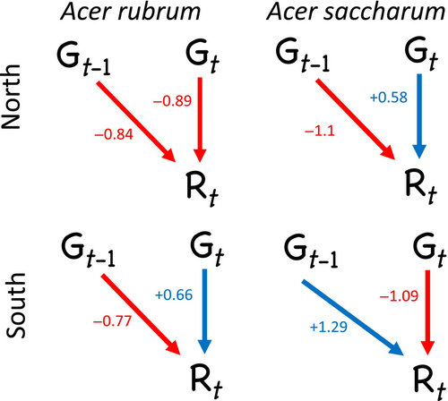
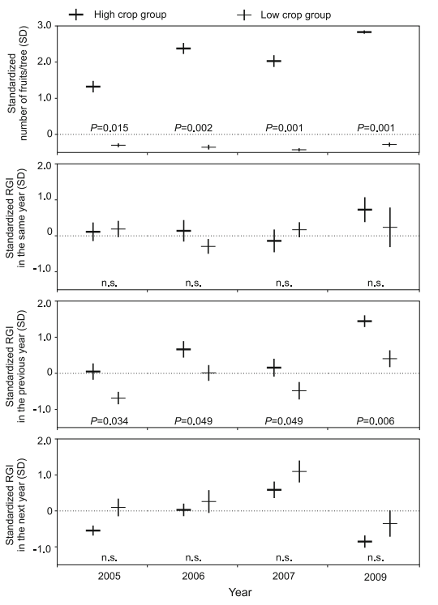
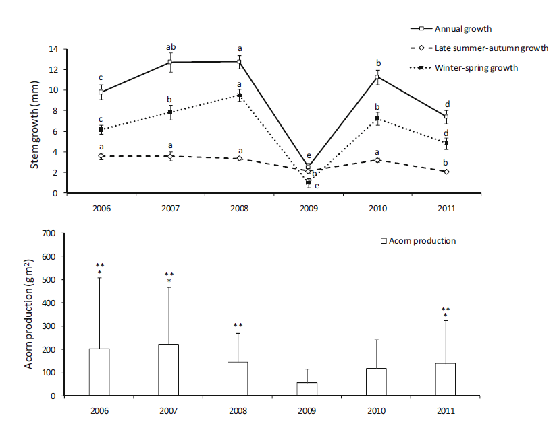
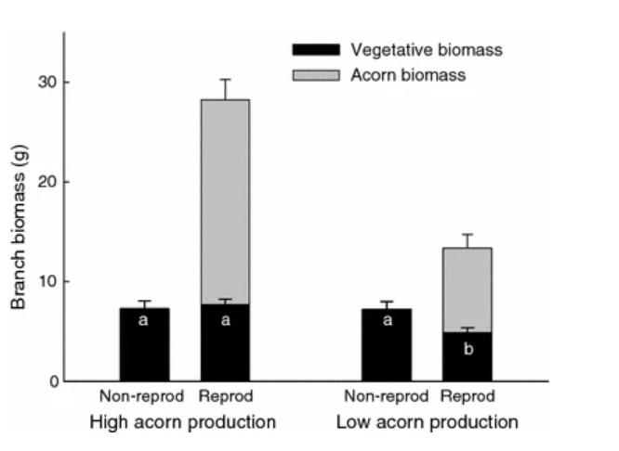
Previous studies

Slide 6
Previous studies
How important the environmental factors are in this relationship
When does the maturation of seeds happen

Slide 7
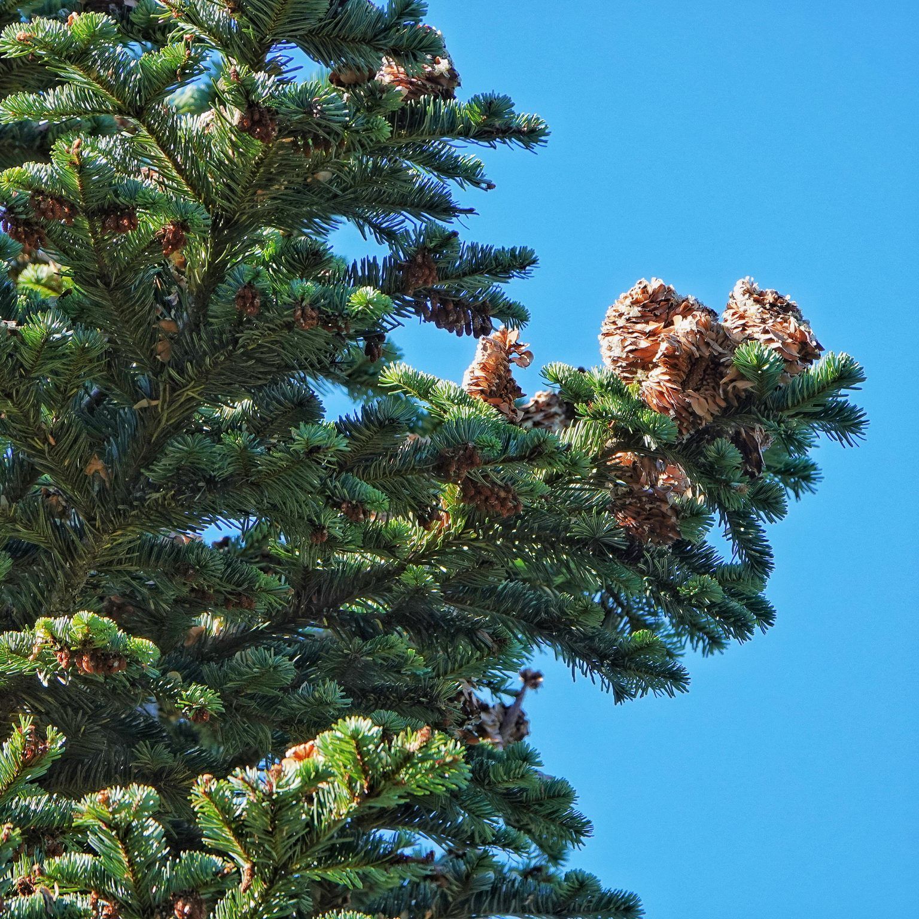
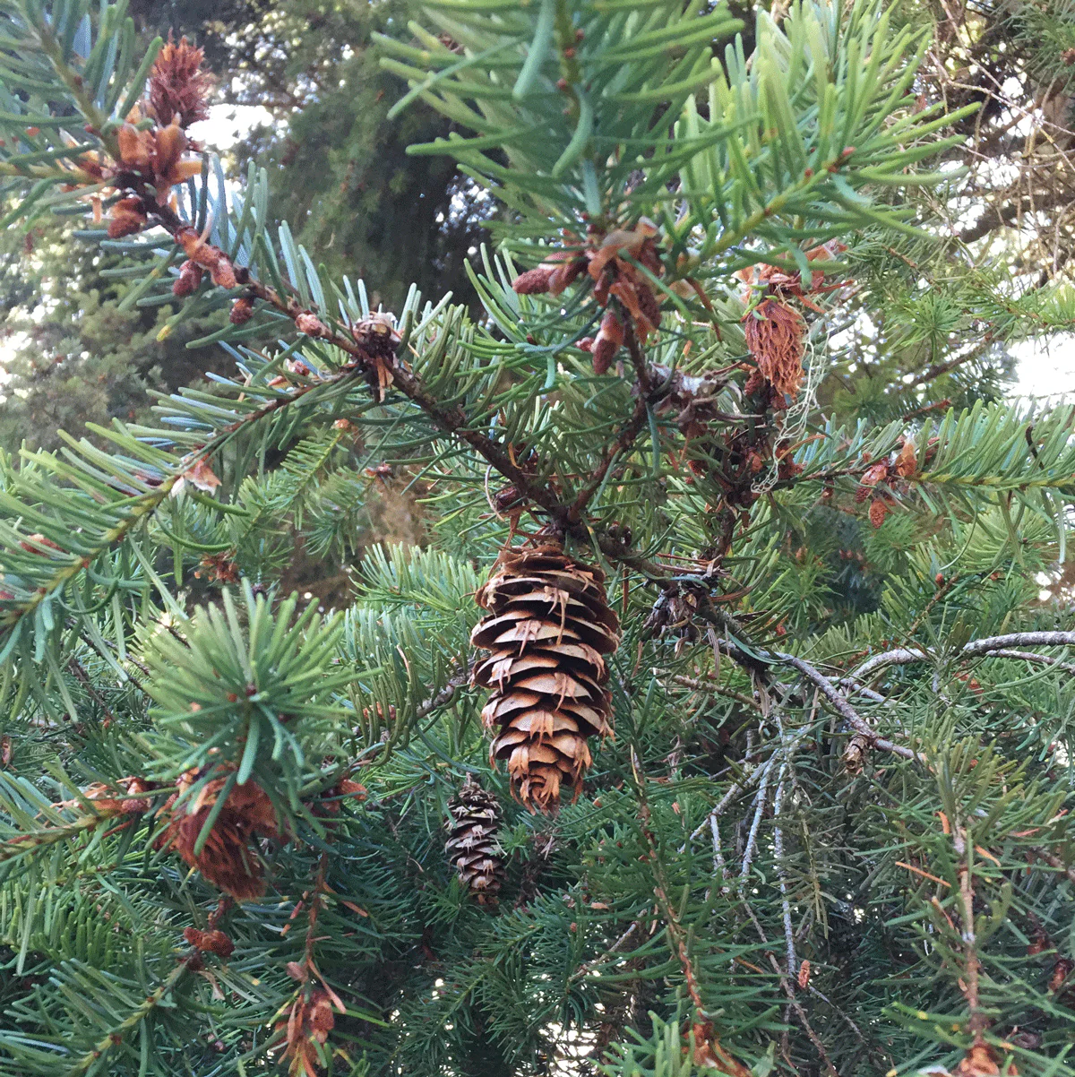
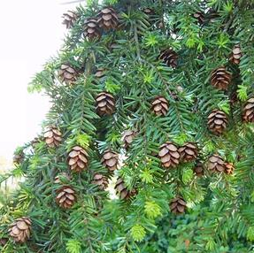
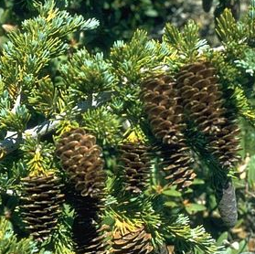
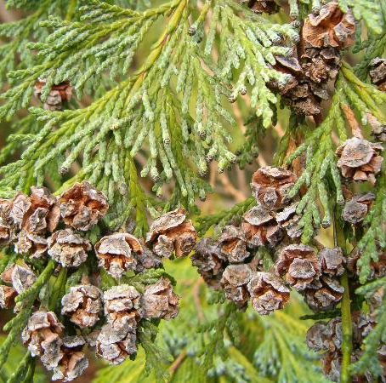
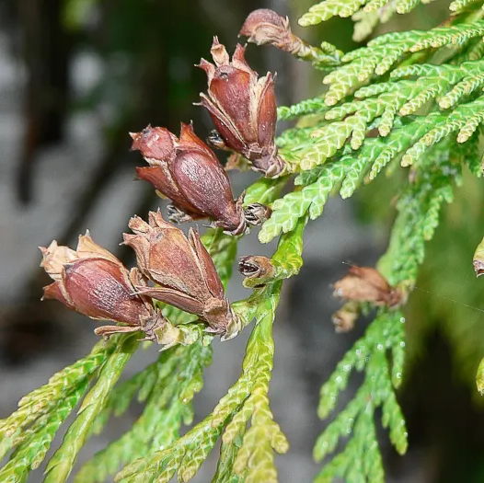
Source: iNaturalist
Abies amabilis
Pacific silver fir
Pseudotsuga menziesii
Douglas-fir
Tsuga heterophylla
Western hemlock
Tsuga mertensiana
Mountain hemlock
Callitropsis nootkatensis
Yellow cedar
Thuja plicata
Western Redcedar
‘Flower’ development | Early fall (1st) | Early fall (1st) | Early fall (1st) | Early fall (1st) | Early fall (1st) | Early fall (1st)
Pollination | Late spring to early summer (2nd) | Spring (2nd) | Early spring (2nd) | Late spring to early summer (2nd) | Late winter to early spring (2nd) | Early spring (2nd)
Fertilization | Late spring or early summer (2nd) | Late spring to early summer (2nd) | Late spring to early summer (2nd) | Mid to late summer (2nd) | Early to mid-spring (2nd) | Late spring (2nd)
Maturation | Summer through early fall (2nd) | Summer through early fall (2nd) | Summer through early fall (2nd) | Mid-summer to early fall (2nd) | Mid-summer (2nd) to fall (3rd) | Late spring to late summer (2nd)
Dispersal | Fall (3rd) | Fall (2nd) | Fall (2nd) | Fall (2nd) | Fall (3rd) | Fall (2nd)

Slide 8
Species with different reproductive cycles
Different elevation indicating different resources they can accumulate
Trade-off between the growth in the previous years, current year, following year of the masting years

Slide 9
Seed_{j,sp,y} ∼ NegBinomial(λ_{j,sp,y}, ϕ)
The modeled seed count (λ_{j,sp,y}) for stand j, species sp, and year y is:
log_{(λj,sp,y)} = α₀ + α_{sp} + α_{j} + β_{1,sp} ・ Growth_{j,sp,y} + β_{2,sp}・ Growth_{j,sp,y−1} + β_{3,sp} ・ Elevation_{j}

